Slide 1
Automatic Building Fault Diagnostic System Using Smartphone
Presented by: Devanshu Kumar
Faculty Mentor: Dr. Alberto Cerpa

Slide 2
Outline
Motivation
Essential Question
Related Work
Framework
Method
Experiments
Result
Demo
Conclude

Slide 3
Scenario
Imagine you are going to work, and it is a very hot day. You reach the office and find out that the zone in the building is not conditioned properly.
You lack the motivation to work => Productivity goes down => Overall loss to the project/business

Slide 4
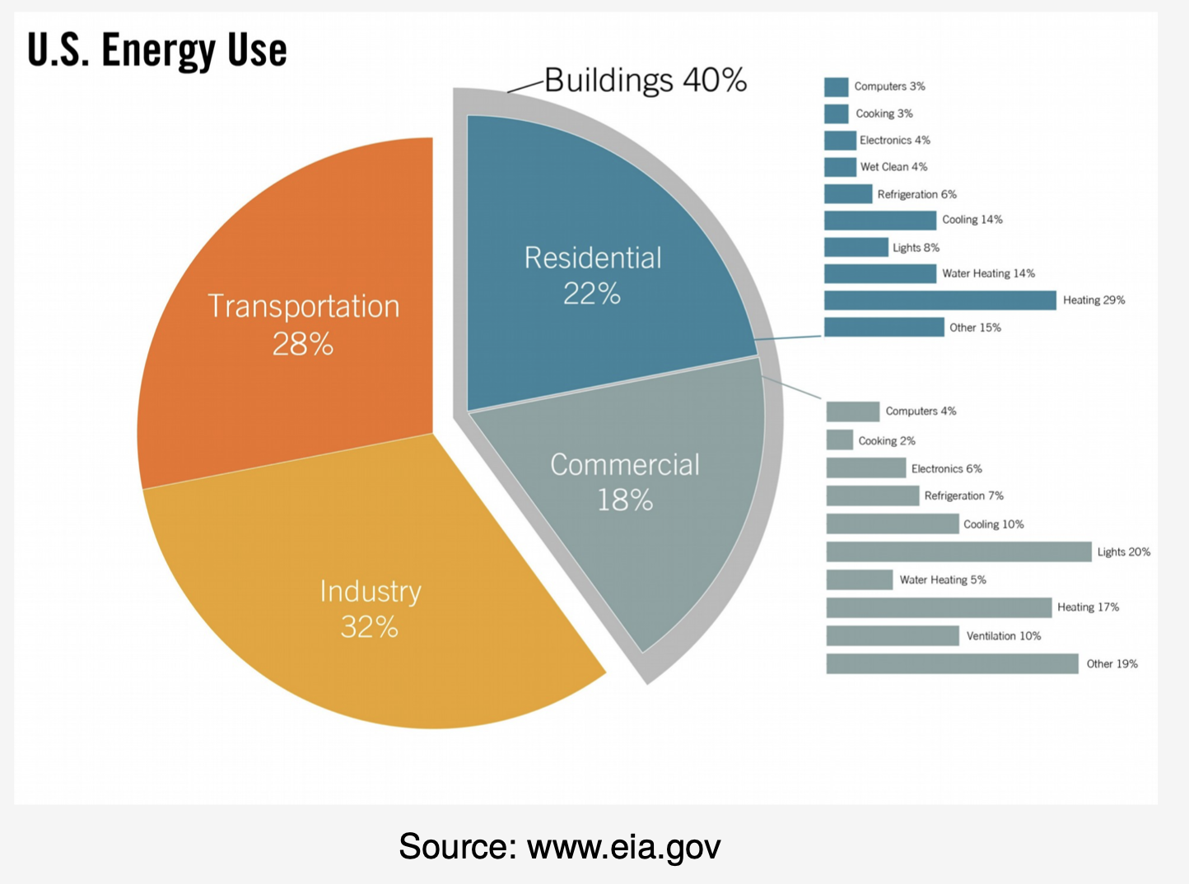
Motivation
Buildings use about 40% of the total US energy in 2017 (Thermovote)
People spend about 87% of their time in building (Wang)
50% of the building’s energy is used by HVAC system
HVAC: Heating, ventilation, and air conditioning
Some papers we have seen related to HVAC:
FORCES
OFFICE
Thermosense

Slide 5
Motivation
What if the building HVAC sensor is feeding false data to the HVAC system?
Poor feedback data -> Wrong inputs to HVAC system -> incorrect parameters for heating/cooling -> User discomfort and energy wastage

Slide 6
Key Components of HVAC
Supply temperature
Outdoor temperature
Air flow (in volume)
Occupancy

Slide 7
Essential Question
How do we develop a cost-effective tool that can be used by HVAC technicians to detect a faulty Building HVAC Sensor?

Slide 8
Related Work
A Method for Fault Detection and Diagnostics in Ventilation Units Using Virtual Sensors:
Propose “mixed model-based and data-driven technique to exploit spatial relations among different components in ventilation units to create virtual sensors and introduce redundancy in the system, which can be used to detect and diagnose faults”
Each sensor is modelled using historical data to estimate readings given other sensors in the unit.
Use ARMAX for statistical analysis and models including regression, support vector machine (SVM), and artificial neural network (ANN).

Slide 9

Virtual Sensors
A type of software that, given the available information, processes what a physical sensor otherwise would.
Idea: You run a simulation and you can then instrument that simulation model with taking measurements at different locations.
Use cases:
Locations with high radiation
Not enough clearance in a mechanical assembly to place the sensor
Cost and reliability

Slide 10
Limitations of this literature
Doesn’t take into account of occupancy
Thermodynamics of a zone can change based on the number of occupancy
It does not work if there are multiple sensor failures
Ex. What if both air volume and supply temperature sensor fails?
Models become invalid using recent data

Slide 11
Our approach
Using a portable sensor capable of sensing air flow and supply temperature, we can train our model with true data using the device’s supply temperature and air flow sensor.
We can then apply the similar approach by training another model for the building data and using Jensen Shannon Divergence to compare how much does the building’s model deviate from the deployed sensor’s

Slide 12
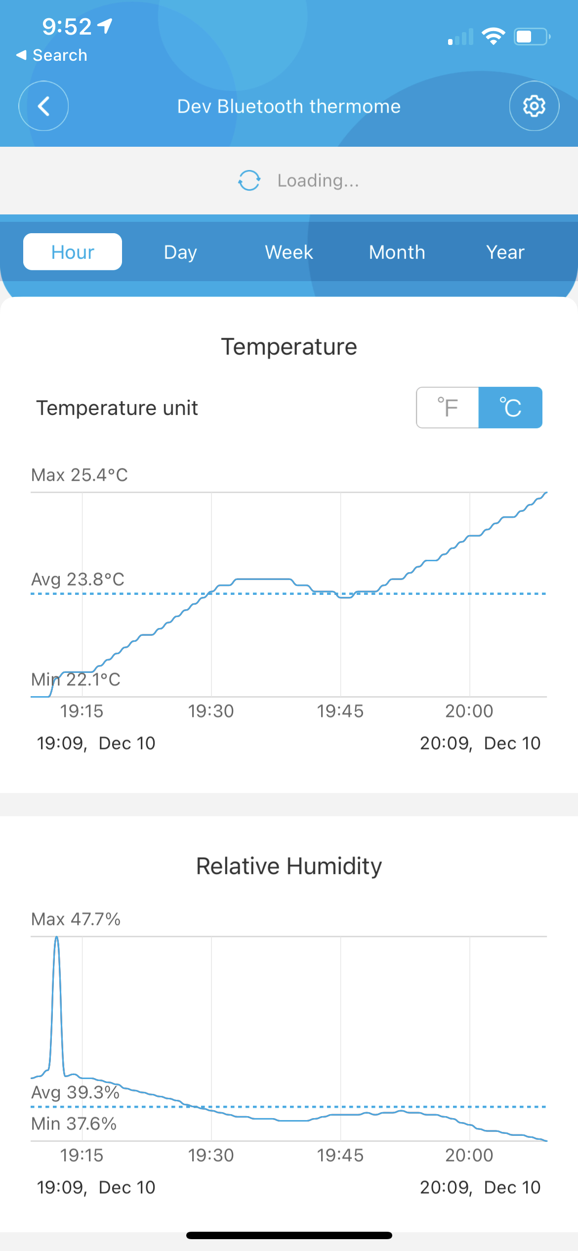
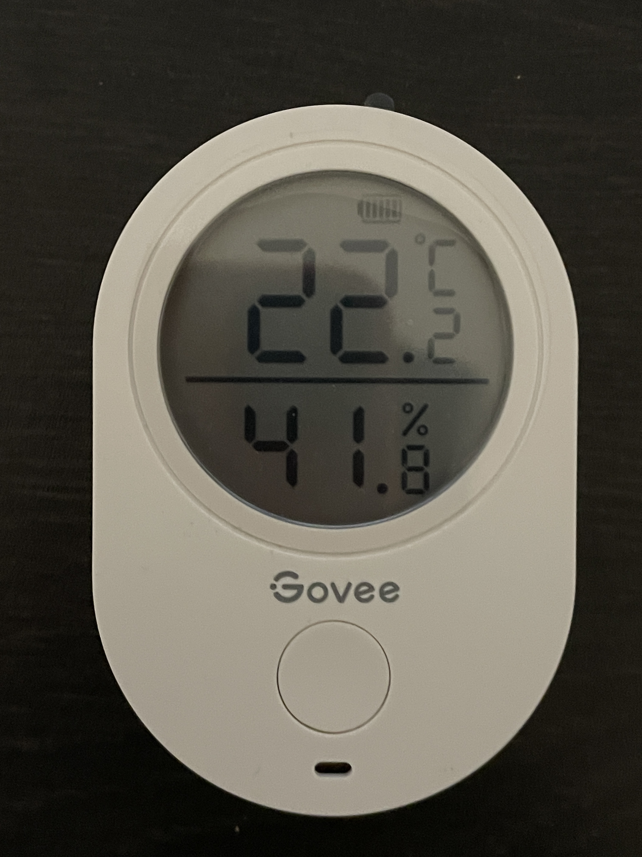
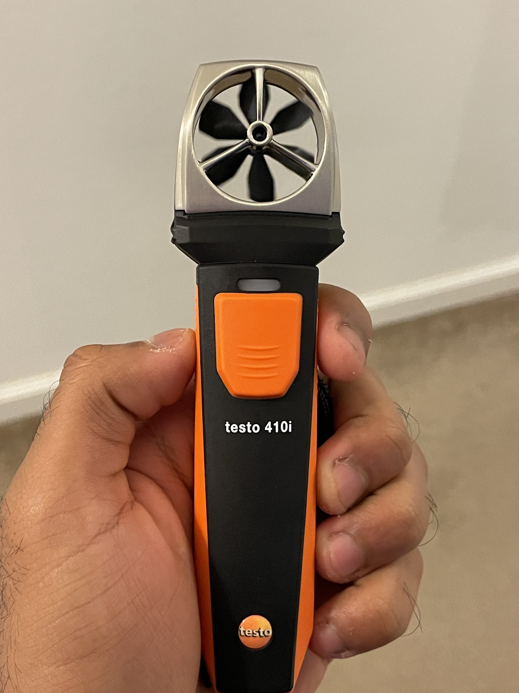
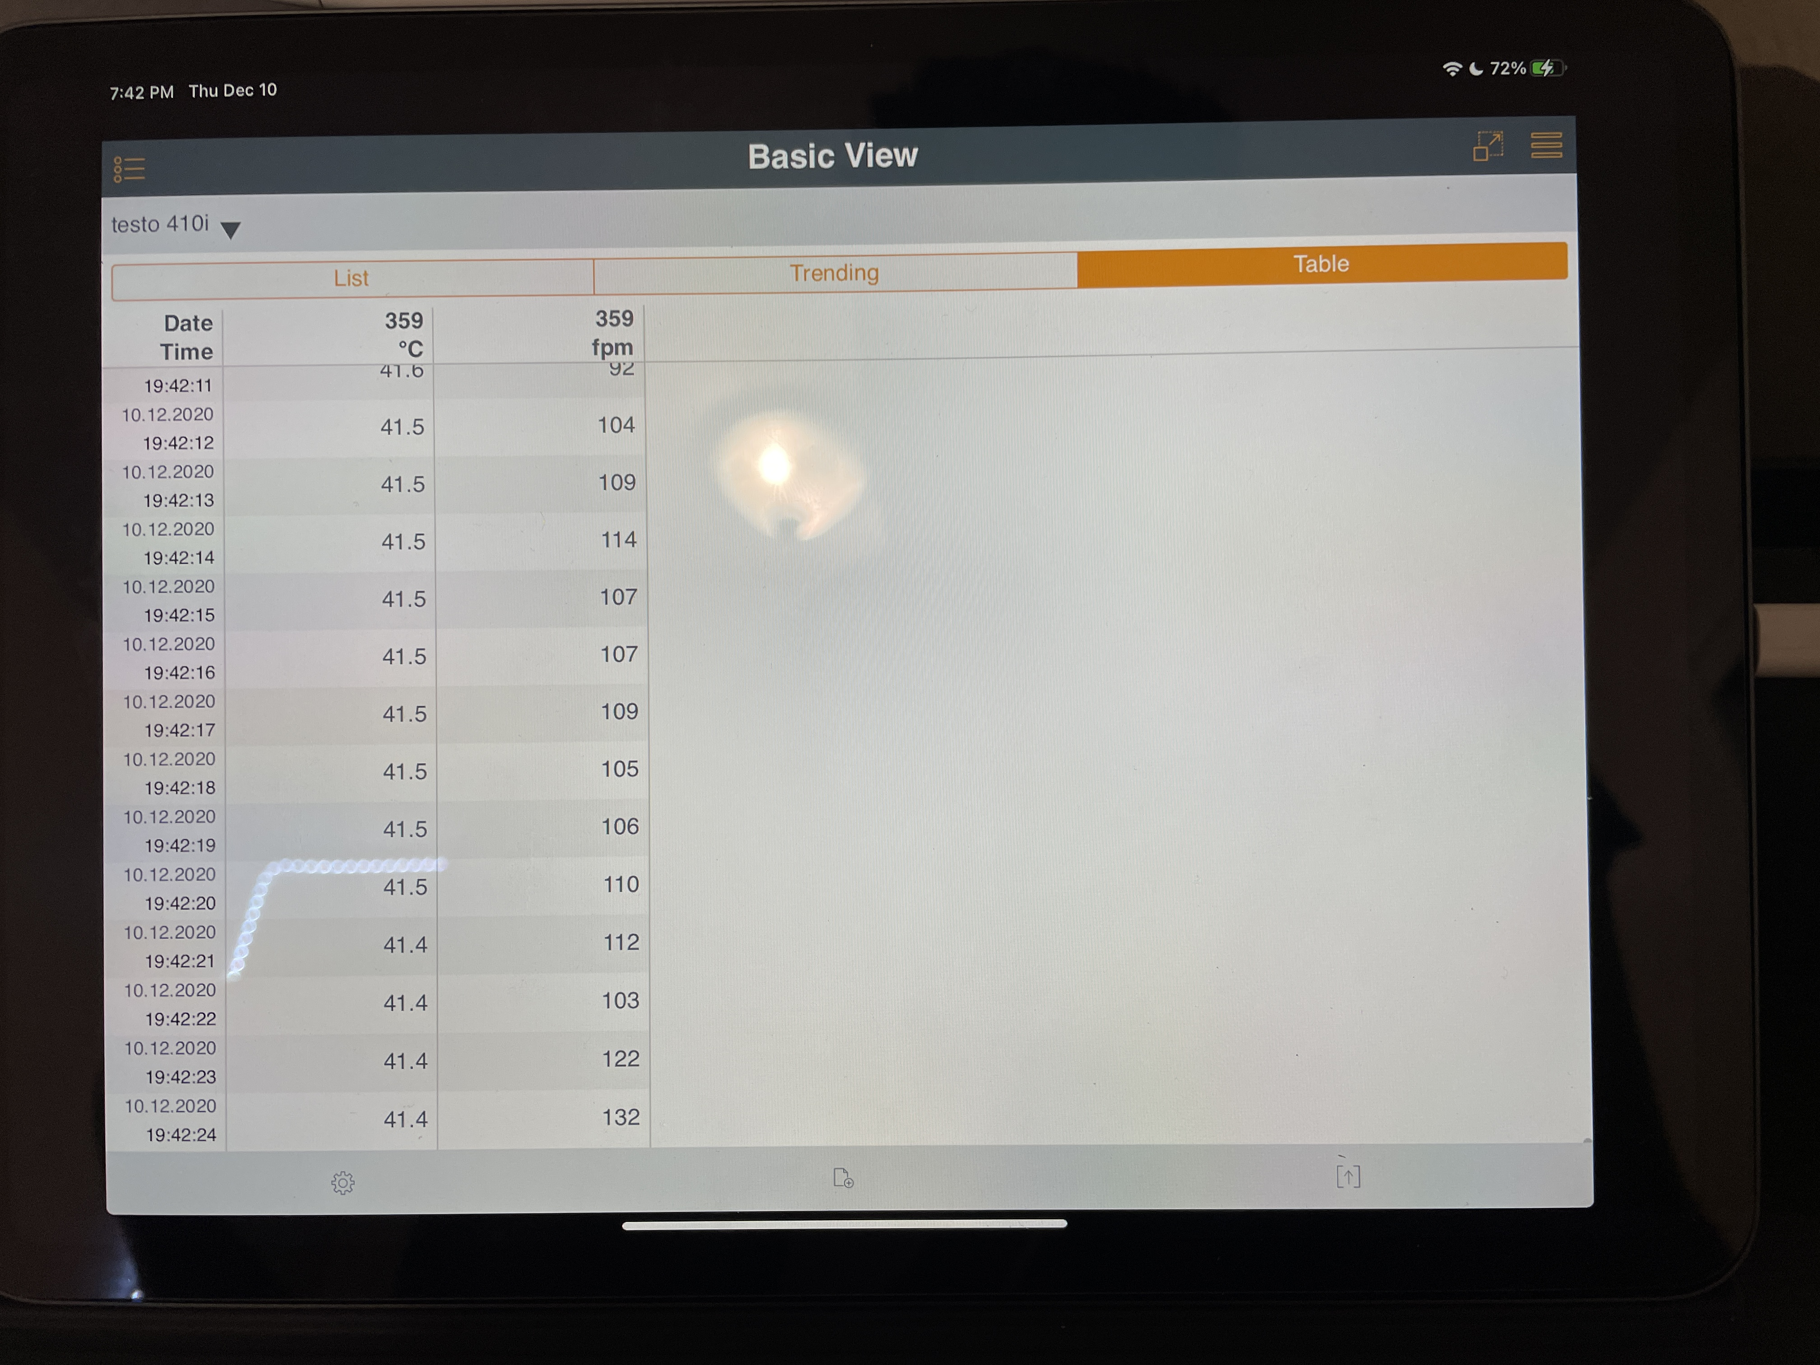
Equipment used and their cost
Testo 410i: $120; Used for measuring supply temperature and air flow
Govee Room temperature sensor: $15; Used for measuring zone temperature.
Total cost = $135

Slide 13

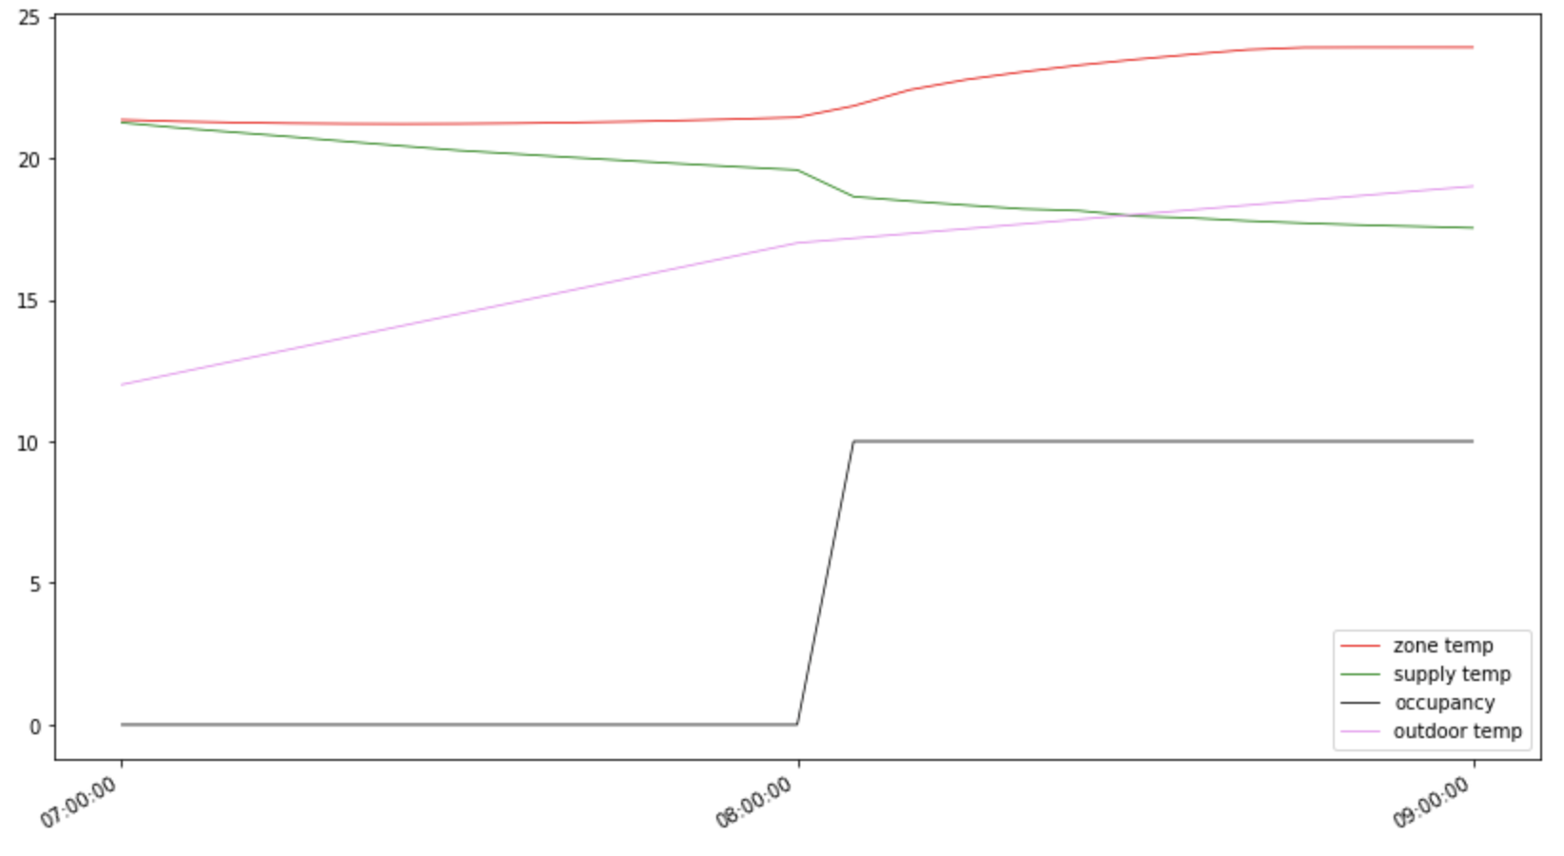




Slide 14
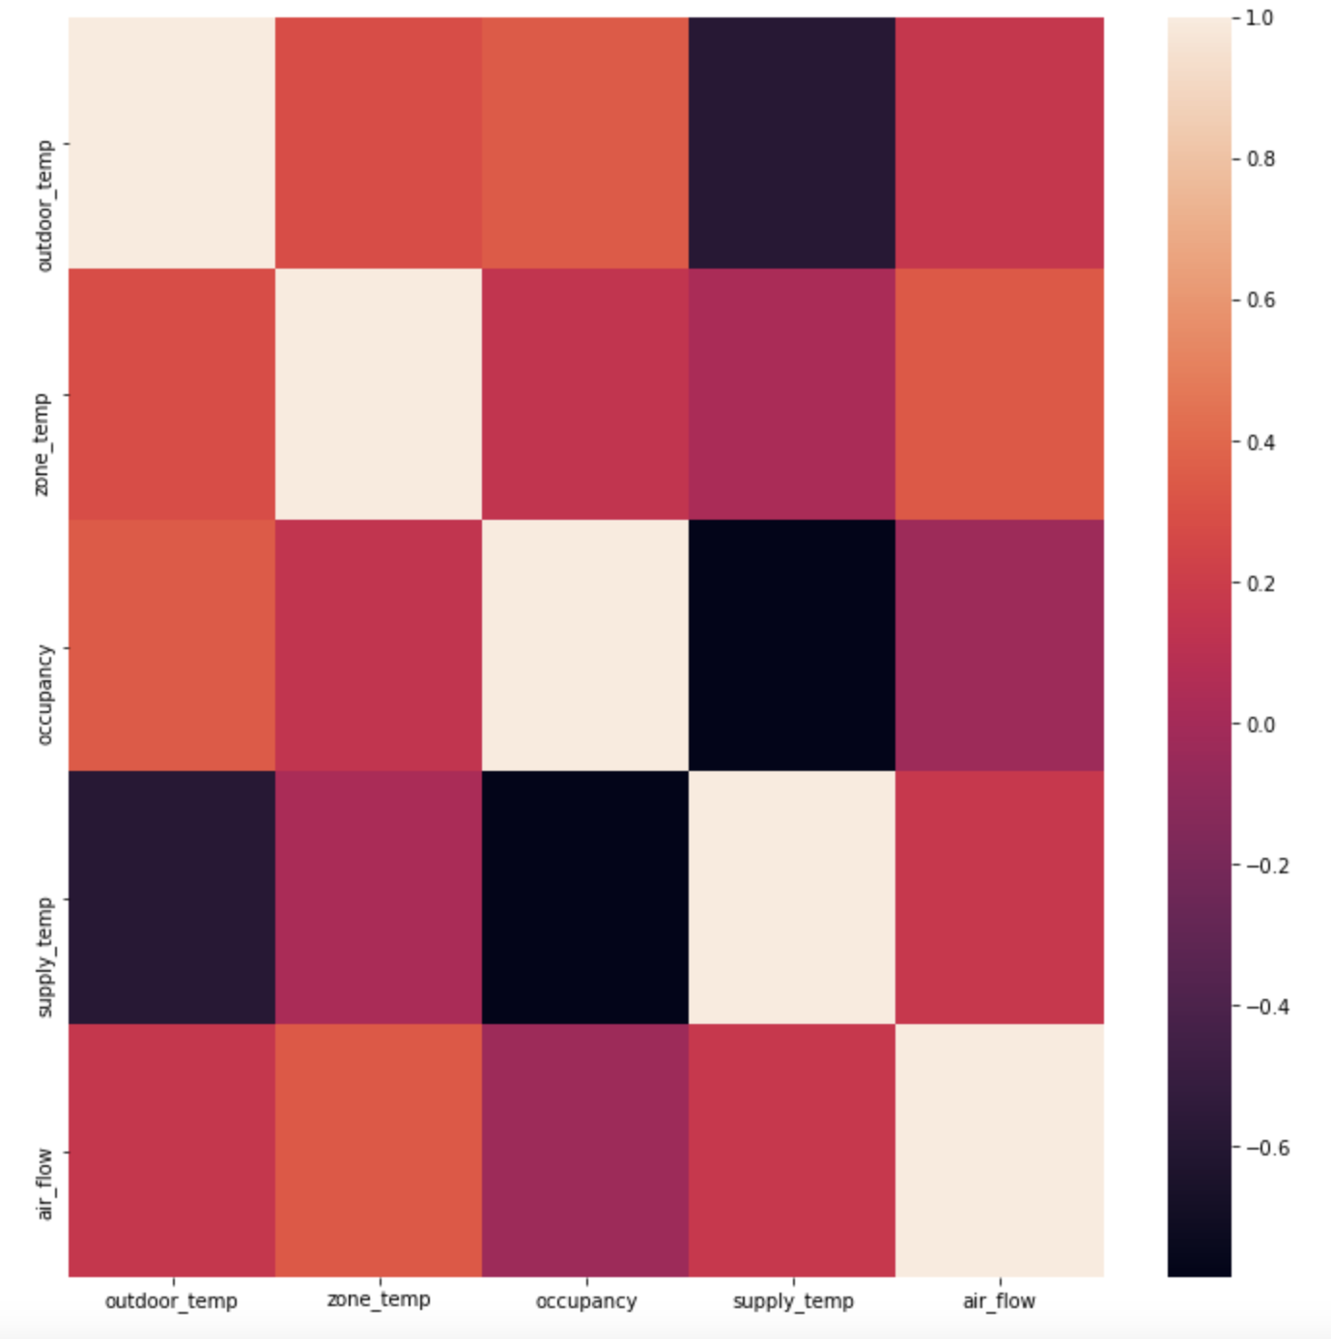

Slide 15
Support Vector Machine Vs OLS Regression
Average (3 random time) | SVM | OLS
RMSE | 0.56 | 0.63

Slide 16
Why SVM?
SVM is a supervised learning model that can be used for regression or classification analysis.
A hyperplane or set of hyperplanes in high dimensionality space are used for classification and regression. It can even detect outliers
A good separation is achieved by the hyperplane that has the largest distance to the nearest training-data point.
ANN was not used because typically we need large data for ANN and it would have been costly in terms of time
Linear regression (OLS) was not used because SVM showed better results with different times of the year.

Slide 17
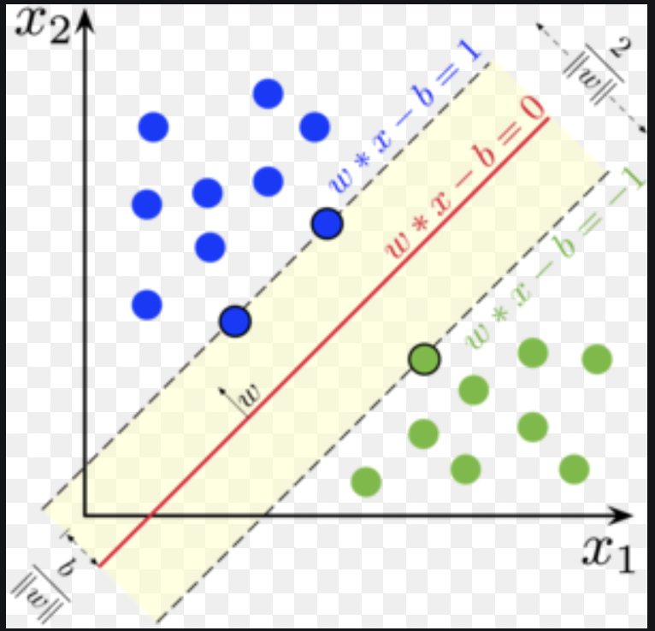

Slide 18

What is Fault-Detect?
Fault-Detect is a cloud based mobile application that addresses the concerns for user (HVAC technicians) to easily determine whether the building sensors are providing false data to the building HVAC system.
It is able to get real-time outside temperature and communicates with your local file storage system to send data to the cloud and use machine learning to provide real-time feedback to the user whether the model thinks it has sufficient data and whether the building sensor is providing false data.

Slide 19



Technologies used to build and host the fault-detect app
AWS S3: Cloud storage for data sets
Openweather map: API service for outside weather
Flask: back-end micro web framework written in Python
Most of the modelling and back-end scripting was done in Python
iOS Swift: To build the UI and front-end functionalities.

Slide 20
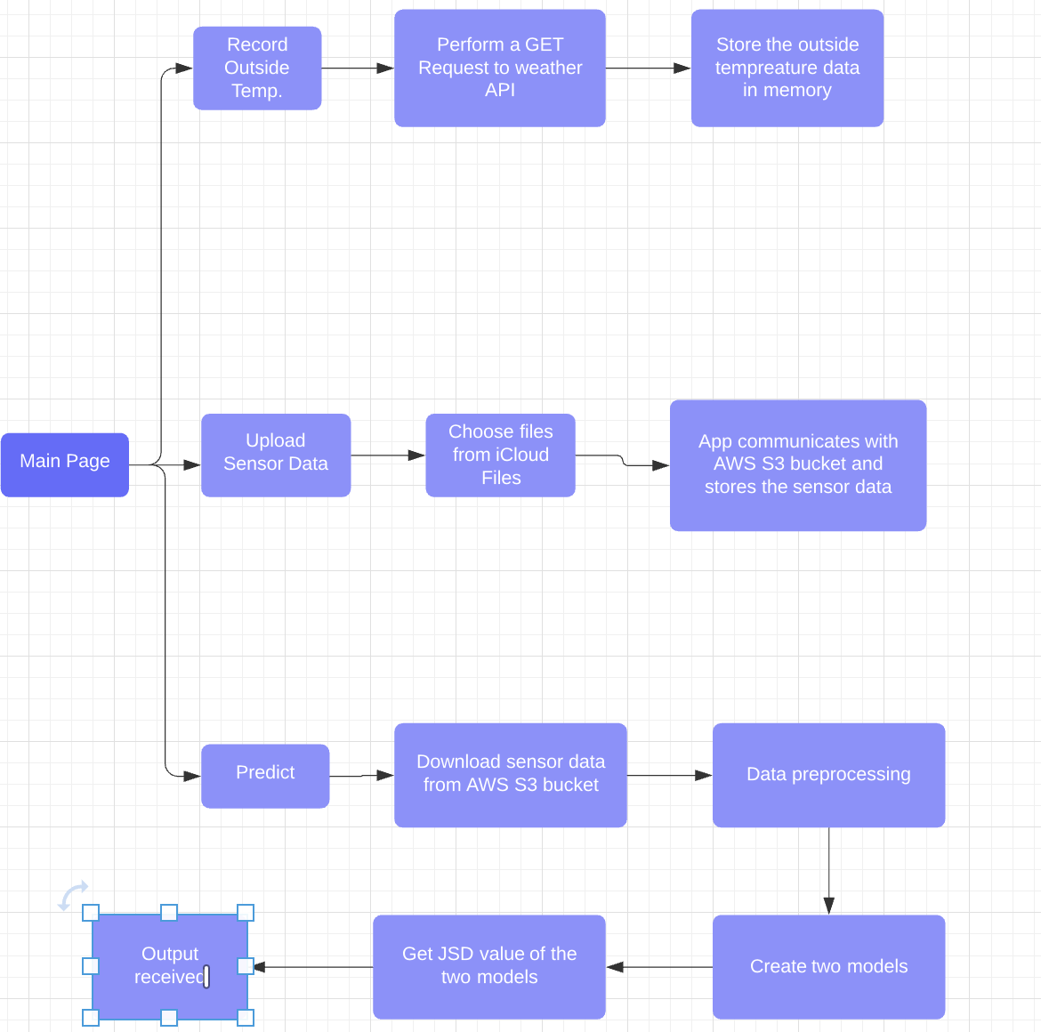
Framework

Slide 21
Steps to follow from consumer’s point of view
Step 1
Deploy the testo Sensor near the vent and place the Govee sensor at a convenient location in the room
Step 2
Open the fault detect app and record the outside temperature
Step 3
Use the testo app to record the supply temperature and air flow
Step 4
Once data is recorded, save the data as a CSV file on your local device
Step 5
Once outside temperature is recorded on the fault detect app, download the room temperature data from the Govee app and follow similar steps like step 4.
Step 6
Upload the two CSV files in the fault detect app.
Step 8
Input the duct’s cross-sectional area
Step 9
Hit the predict button and you will have the result!

Slide 22
Experiment
Due to Covid-19 and restricted lab access, we could not get the experiment done in a lab space/building.
Two experiments were conducted:
November 14, 2020
December 10, 2020
Control: Experiment was conducted in the living room of the house with occupancy of 2 people
Time period: Data was collected for a 1-hour period

Slide 23
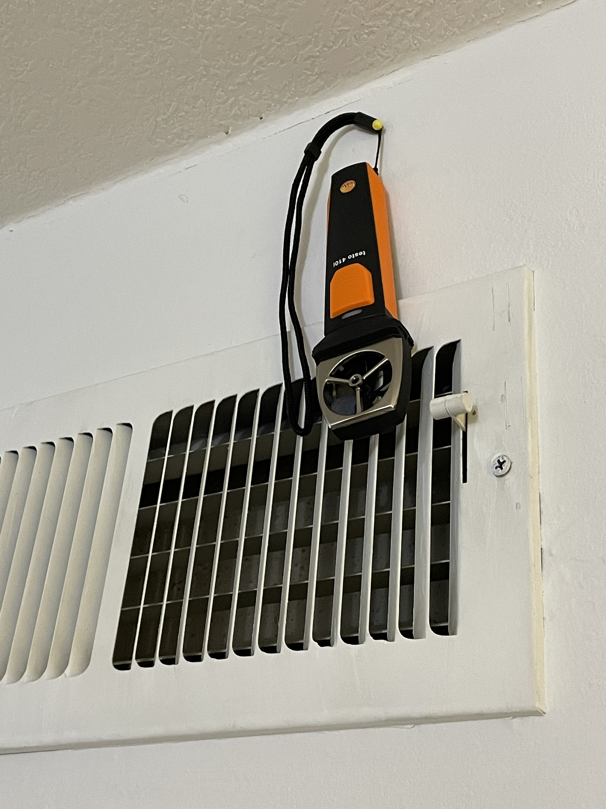
Experiment
Procedure:
Testo Sensor was setup
Goove room temperature was placed in the room
Used a simulated building data for comparison
Estimated vent area: 0.54 sq.ft
JSD threshold = 0.50
80% data used for training

Slide 24
Results
Date | RMSE for Model 1 (Sensor Data) | RMSE for Model 2 (Building data) | JSD
11/14/2020 | 1.08 | 0.0015 | 0.693
12/10/2020 | 1.28 | 0.13 | 0.693
Final result: Diverging
RMSE: Root mean squared error
Lower = more accuracy

Slide 25
Discussion and future goals
Experiment was not performed in “Apples to Apples” manner:
Location of the simulated building was unknown
The data was from 2017
Building vs home => different systems
Future goals:
Provide flexibility to help calculate duct area using device
Perform experiments in actual buildings

Slide 26
Conclusion and Future goals
With one hour of recorded data, we are able to generate an accurate model.
For future: we hope to have access to lab space and perform a similar experiment
SVM models have been promising in literature and have shown to be working better in this case compared to other models

Slide 27
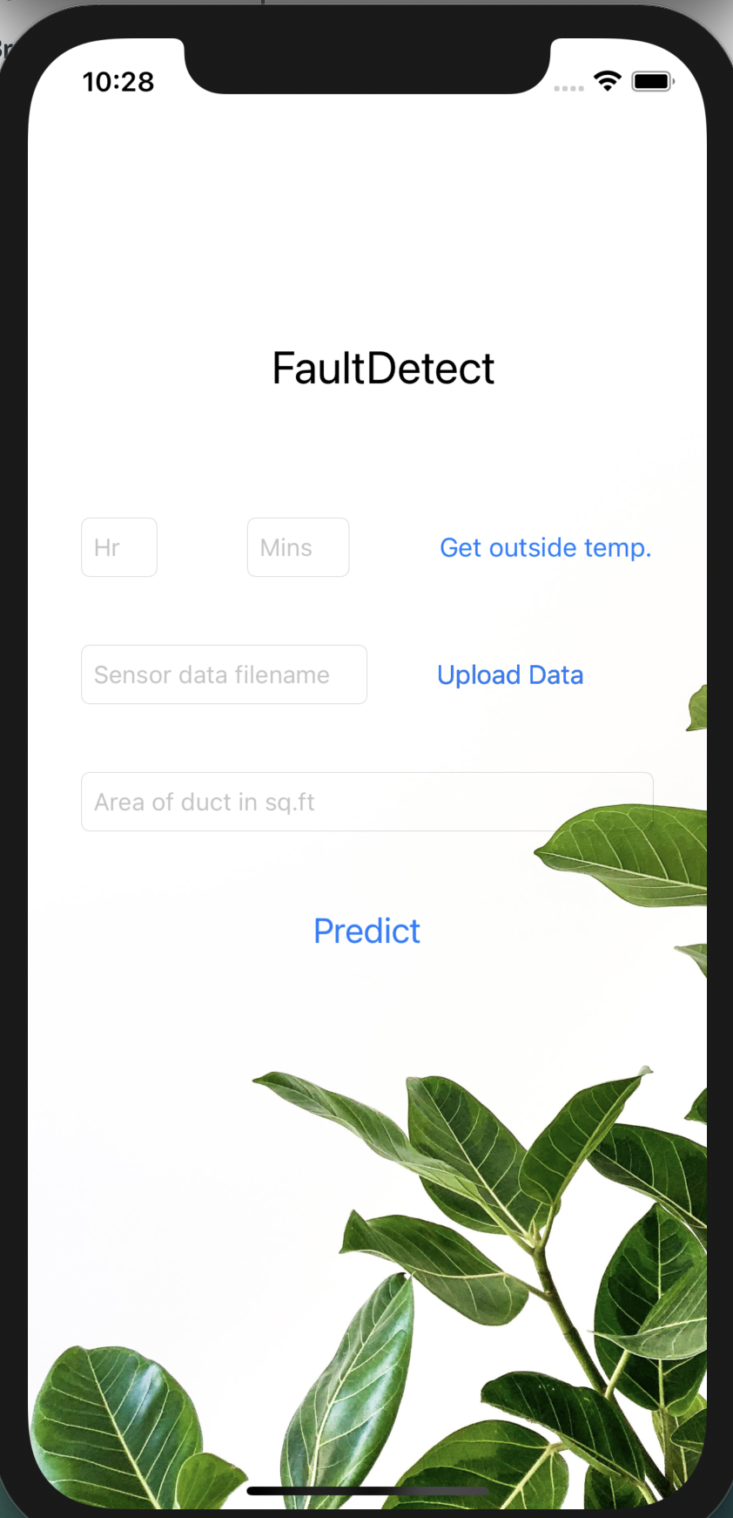
Demo

Slide 28
Thank you
Special thanks:
Dr. Alberto Cerpa
Xianzhong Ding
Thank you all for watching my presentation

Slide 29
Work Cited
Erickson, Varick L., and Alberto E. Cerpa. "Thermovote: participatory sensing for efficient building hvac conditioning." Proceedings of the Fourth ACM Workshop on Embedded Sensing Systems for Energy-Efficiency in Buildings. 2012.
Mattera, Claudio Giovanni, et al. "A method for fault detection and diagnostics in ventilation units using virtual sensors." Sensors 18.11 (2018): 3931.
Wang et al, “The Squeaky wheel”, Building and Environment, 2019

